Slide 1
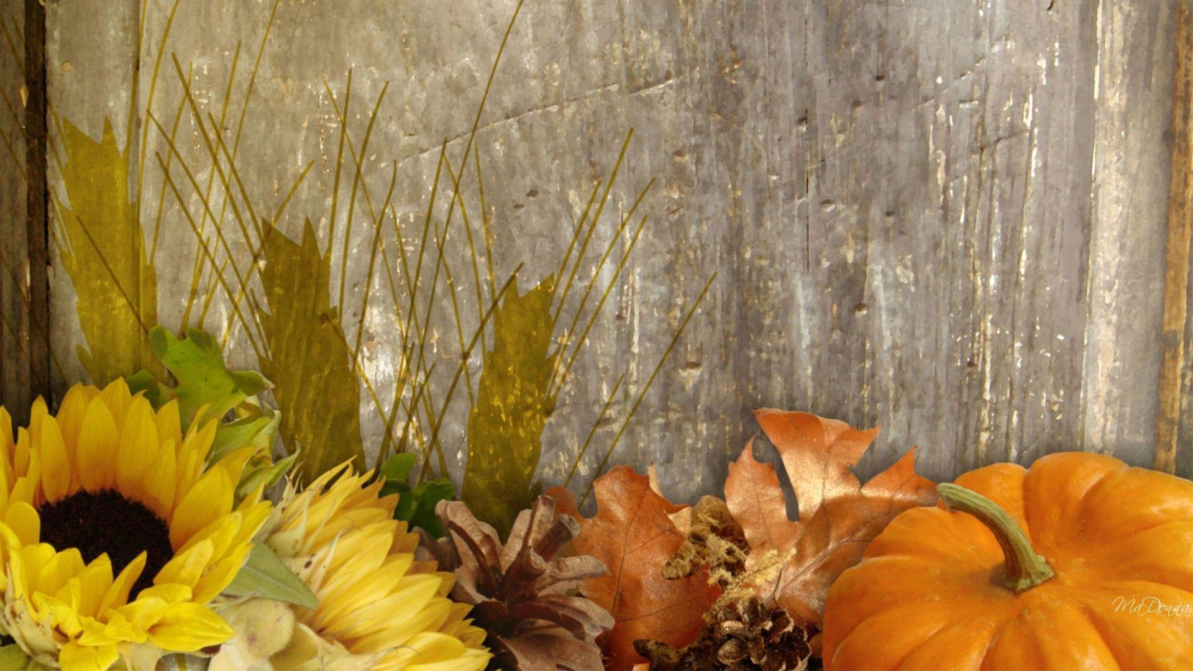
Harvest Poem and Prayers
Redeemer Ethos Council
Notes:
Music link – play the music softly as the children read the prayers etc

Slide 2

Colourful fruit and veg, growing through all the fields.
Rows and rows of beautiful ripe radishes.
Orange carrots growing though the earth’s soil, ready to be picked to eat.
Perfectly grown pineapples sprouting from trees.
Seeing all these fruit and veg makes us think about all the people that don’t have warmth, food and shelter.
Katie and Isabelle

Slide 3
I open my eyes to see the crops grow.
The harvest sun sines on me.
Carrots, cauliflowers, apples, mango, strawberries and more.
I open my eyes to see the crops grow.
Tasty looking vegetables, I know.
The harvest sun shines on me
The joy it brings is dear to see.
Carrots, cauliflowers, apples, mango, strawberries and more.
This harvest time let us give food to those in need.
Poppi

Slide 4
Dear Lord
Please help us to be thankful for this harvest season .
We are thankful for the food we eat, the crops that have been sown and the farmers that have helped the crops to grow.
We thank you for the summer sunshine and the spring rain that have provided the crops with all the goodness and nutrients they need
Please help us to think about all the people in the world that might not have enough food ,shelter and warmth this harvest time. We pray that the kindness of others will help to bring everyone together this season.
Let us have faith in you and give thanks for all the goodness you provide. Help us to care for our planet so we can have many more harvests to come.
Help us to come together and celebrate this amazing season.
Amen
Isabelle

Slide 5
Dear Lord
At harvest time we thank you for so many things.
For the sunshine and rain to help the crops grow.
For the farmers and the tools to help harvest the fruit and vegetables.
For the lorries and drivers who transport the food to the shops.
For the shop workers who stock the shelves.
We also pray for those people who may not have the money to buy enough food.
We thank you for the volunteers in the Food Bank who help those people who otherwise may go hungry.
We thank everyone here who has brought food donations today.
Lord, help us to be kind to others in thoughts and words and deeds.
Amen
Katie

Slide 6
Dear Lord ,
Thank you for all you give to me, each and every day of the week.
Help me to be kind and considerate.
But most importantly …
Grateful -
For all you give to me .
Amen
The Ethos Group
Notes:
Oscar read this

