Slide 1
Changing Me
07.06.23

Slide 2
Questions – Please ask after the presentation (one-to-one)
Materials – Available to look at in the corridor after the session

Slide 3

Changing Me
Summer 2; every year group learns about the body
Learning about how we children can be supported during times of change as well as changes in the body – Puberty Changes
We do not teach sex education
(No intercourse, pregnancy, conception, birth)

Slide 4

Why?
No National Curriculum
RSE Framework
https://assets.publishing.service.gov.uk/government/uploads/system/uploads/attachment_data/file/1090195/Relationships_Education_RSE_and_Health_Education.pdf

Slide 5
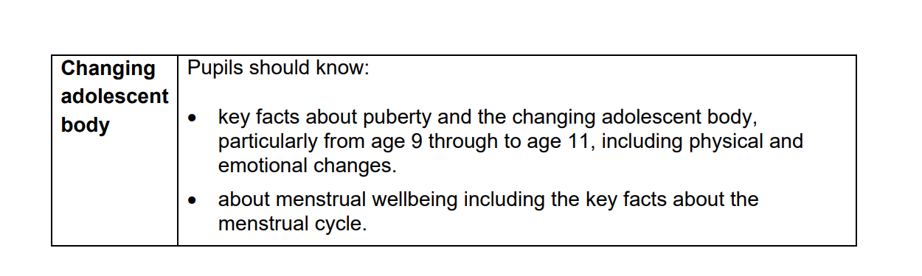
Why? - Legal
“Primary schools should teach about relationships and health, including puberty” p.23
“ensure both boys and girls are prepared for the changes that adolescence brings and – drawing on knowledge of the human life cycle set out in the national curriculum for science –” p.23
P.35

Slide 6

Why? – Moral Duty
Safeguarding, all children need to know about their bodies (and the correct terms) to keep themselves safe.
We want all children to be safe, happy and healthy and they need to know about their bodies to achieve this
Beat stigma around discussing the body as it can cause children to not express worries or problems they may have to a key adult.
Combating other influences - ‘Children’s heads aren’t empty’
Social Media, Peers, Body Image, Advertising etc.
- We want our children to be be able to empathise and support all of those around them and now the whole school community is there to support them.

Slide 7

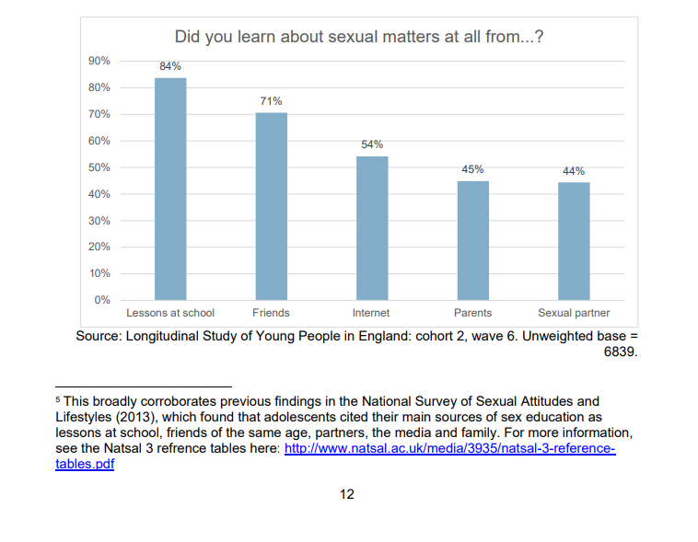
Why?
https://assets.publishing.service.gov.uk/government/uploads/system/uploads/attachment_data/file/1035862/SRE_and_sexual_risk-taking_research_brief_Nov21.pdf

Slide 8

How? – Integrated Curriculum Drip-Drip
We want to keep the discussion low key
Normalise it
We spiral our curriculum so children revisit key knowledge to strengthen their memory.
It also allows children to explore the topic as they mature and allows them to answer any queries they may have

Slide 9
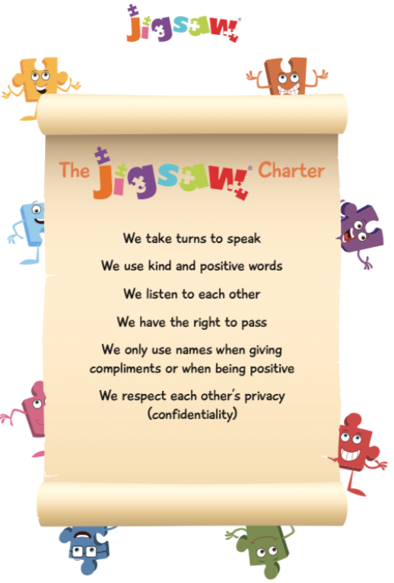
How? - Clear expectations in the classroom
- It’s ok not to know
- No personal information
- Correct names for body parts
- Respect preferences and beliefs
It’s ok to giggle
Conversation doesn’t go to the playground

Slide 10
How? – Pedagogy
Teach the lesson like any other
Class teacher teaches
Dispassionate like a Science lesson
Speak in facts
Jigsaw appropriate tasks
No cold calling

Slide 11
How? - Groupings
Keep all children together
SLT, PSHE Lead and class teacher to look if anything else is necessary

Slide 12
How? – Advice to teachers for questions on the spot
Keep answers straight and factual
Age-appropriate answers (guided by the years content)
“That is something you will discuss later in school”
It’s ok so say you “don’t know.” You can come back to it later
Contact DSL and parents if concerned

Slide 13
How? – Questions: Ask it Basket
- Basket to be available in class all half term. Teachers should check weekly.
- Pupils as questions. Teachers discretion whether a whole class discussion or one-to-one.
- Children should write names on post-it-note.

Slide 14
How? - Withdrawal
Parents can only withdraw from sex education.
Therefore, parents cannot withdraw in our school.
Any discussions of this nature should be passed to a member of the Senior Leadership Team.

Slide 15
What? – Content
How do we know what to teach?
Jigsaw, a scheme we have bought into that advises us on how to structure the content.
Medium Term Plans, we then choose what we think is appropriate and have created Redeemer Medium Term Plans that teachers follow.
Knowledge Organisers, we have then created documents that are shared with pupils and parents/carers that have the key vocabulary taught and the definitions that the children are introduced to.
These can be views on the RHSE page

Slide 16

Why? – A Story

