Slide 1
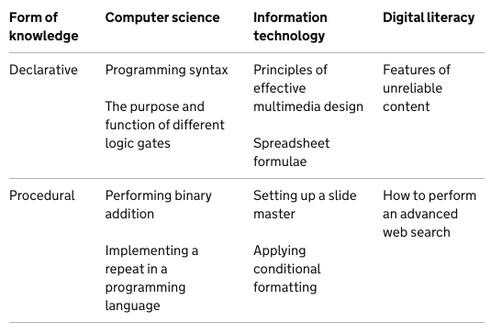

Slide 2

Computing Domains of Knowledge
Computer Science
EYFS | Year 1 | Year 2
Awareness of the cause and effect of technology Can use technology to express creatively and constructively | Coding Understand what algorithms are and to write their own. Know how to work out what is wrong with a simple algorithm when the steps are out of order, e.g. The Wrong Sandwich in Purple Mash Be able to make good guesses of what is going to happen in a program. For example, where the turtle might go. Create and debug simple programs. | Coding Show an awareness of the need to be precise with their algorithms Know how to create a simple program that achieves a specific purpose. Be able to identify and correct some errors, e.g. Debug Challenges Understand programs execute by following precise and unambiguous instructions

Slide 3
Computing Domains of Knowledge
Computer Science
Year 3 | Year 4 | Year 5 | Year 6
Make a physical situation into an algorithm for a program. Design an algorithm carefully Identify an error in my program Understand what a variable is Design, write and debug programs that accomplish specific goals Use sequence, selection and repetition in programs Detect and correct errors in algorithms and programs Can repeat a sequence of code | Experiment with timers in my programs Can repeat a set of code using commands Use selection (decision) in my programming. For example, using an ‘if statement’ for a question being asked and the program takes one of two paths Use variables within my program and know how to change the value of variables | Solve problems by decomposing them into smaller parts Use sequence, selection, repetition, and some other coding structures in my code. Organise my code carefully for example, naming variables/tabs Use logical methods to identify the cause of any bugs Design, write and debug programs that accomplish specific goals Solve problems by decomposing them into smaller parts. | Turn a more complex programming task into an algorithm by identifying the important aspects of the task (abstraction) and then decomposing them in a logical way using their knowledge of possible coding structures and applying skills from previous programs. Coding displays an improving understanding of variables in coding, outputs such as sound and movement, inputs from the user of the program such as button clicks and the value of functions.

Slide 4
Computing Domains of Knowledge
Information Technology
EYFS | Year 1 | Year 2
Awareness of different technologies in and out of school Awareness of digital storage of information – photography, digital writing and research information | Maze explorers Know how to create a basic set of instructions Understand what an algorithm is and how they are used Animated Story Books Can create an e-book | Questioning Know the different type of questions Can use a binary tree to find an answer Paint Can create a picture using Paint Making Music Can make music using an application

Slide 5
Computing Domains of Knowledge
Information Technology
Year 3 | Year 4 | Year 5 | Year 6
Simulations Understand what a simulation is 3D Modelling Know what a 3D net is and what they can create Graphing Know what data is Understand how data can be displayed in a graph Branching Databases Understand what a Yes/No question is Create their own branching database | Making Music Features of rock music in GarageBand Can create a piece of music using GarageBand Logo Can use 2Logo effectively Animation Understand how animations can be created Can create an animation to fit a story | 3D Modelling Can create a 3D model to fit a purpose Game Creator Understand 2DIY 3D tool can be used for multiple uses Can create characters and items for a game Concept Map Understand what a concept map is | Quizzing Know that a multiple choice question can be used to find information Understand how a quiz can be used Blogging Know what a Blog is and what they can be used for Website design What is a website

Slide 6
Computing Domains of Knowledge
Digital Literacy
EYFS | Year 1 | Year 2
Awareness of input and outputs of devices Know how different parts of a computer work | Word Can access word and insert text. Edit text and add capital letters. Know the function of the undo and redo button. | Word Can use symbols Know what WordArt is and use it Highlight words and make lists PowerPoint Understand what a presentation is Can add text to a new slide, move slides Add an image to a presentation

Slide 7
Computing Domains of Knowledge
Digital Literacy
Year 3 | Year 4 | Year 5 | Year 6
Word Can insert and edit An image Know how to change the position of text Understand what The cut,copy and Paste functions can Be used for Excel Understand what a spreadsheet is Can input data | Word Can download and insert images from the internet Add a header and footer Can effectively use the dictionary and thesaurus PowerPoint Can add extra features to presentations: Animations, sounds, music and videos | Word Know how to insert tables and text boxes Make effective use of fonts and shapes Excel Know how data is represented in a spreadsheet Can apply formulae Use formula to tackle real life problems | Word Can insert graphs created in excel Add links PowerPoint Can effectively edit a presentation Know how icons can be used

Slide 8
Computing Domains of Knowledge
Online Safety
EYFS | Year 1 | Year 2
Know how to respect equipment Understand the importance of telling an adult if they feel unsafe or unsure | What a computer is and how they can be dangerous. Why it is important to keep personal information safe What to do if we see something we shouldn’t | What the internet is and how it can be safely used How to keep ourselves safe on the internet and what to do if we are unsure.

Slide 9
Computing Domains of Knowledge
Online Safety
Year 3 | Year 4 | Year 5 | Year 6
Know which online games are suitable for children Understand games can be educational How to game safely | Understand the many uses for electronic devices Why we should limit our screen time Most important uses of electronic devices | How we communicate online Understand what inappropriate communication is and how to report it | Have an understanding of what information is available on the internet Know the internet keeps a digital footprint

